Slide 1
Abstract
It’s easy to feel helpless when developing software when what we’re asked to do is constantly changing, unclear, or lacks criteria to demonstrate “done”.
Developers must be agile—recognizing and responding to change—but not all changes are equal. Any product must have purpose; changes that contradict the vision or mission create uncertainty, frustration, and quality issues.
This session digs into how business motivation relates to product engineering and how those relationships can be mined and leveraged to not only ensure the software development effort is on track but also to ensure expectations are realistic and focused.
Proven techniques to scope the effort and focus expectations will be detailed, including:
understanding the business motivation
questions to ask when business motivation is unclear or contradictory
creating sensible software development goals and objectives
translating motivation to quality attributes
separating product engineering from experimentation
encouraging clear and achievable acceptance criteria
using estimation and time-boxing to scope efforts

Slide 2
When Clear Expectations are Lacking, Succeeding as a Software Developer
Peter Ritchie

Slide 3
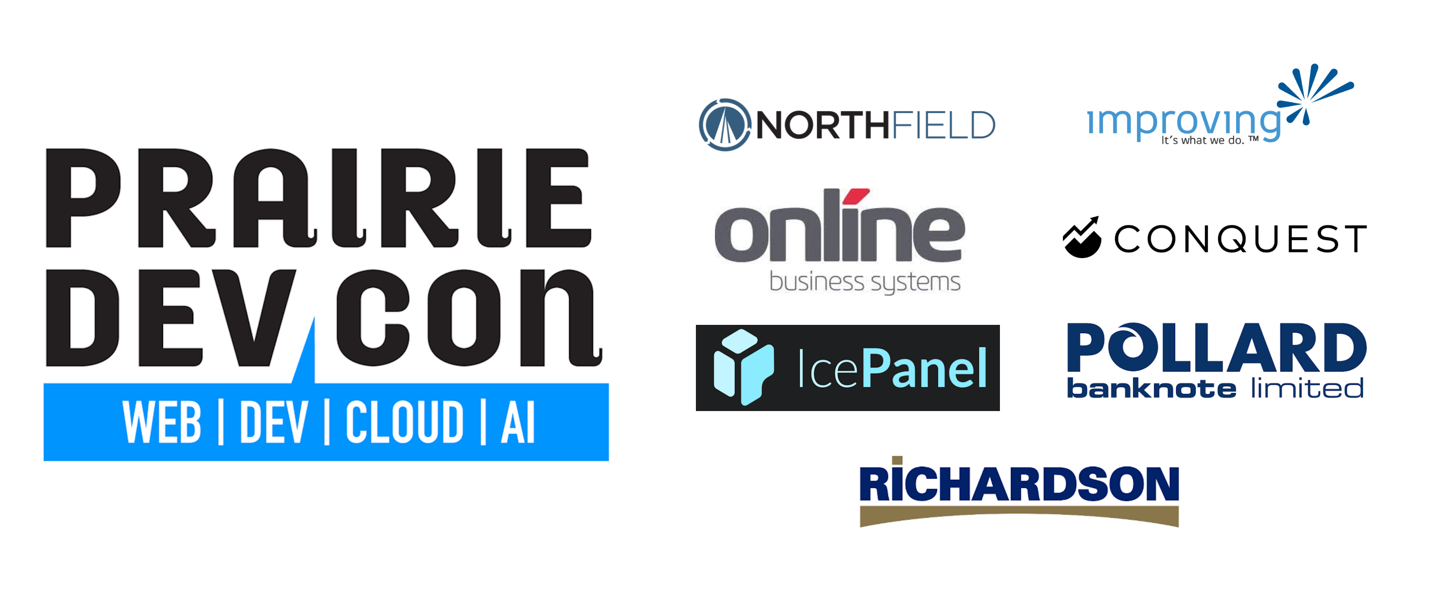

Slide 4
About me
Freelance technologist specializing in helping teams deliver software solutions
Software Architect
Fractional Solution Architect
Fractional Developer Lead
In industry for over 30 years
Author of 3 books on .NET Development
Former Microsoft MVP award in .NET (13), ASP.NET Insider
Certified Azure, SAFe, and SOA

Slide 5
Agenda
Level setting
Agility vs “Agile”
Agile assets
Leveraging existing expectations
Mining implied expectations
Navigating business motivation

Slide 6
Level-Setting
Assumption
Agile Practices
User Story
Backlogs
Features
Epics

Slide 7
Why?
Have you ever?
Agreed on work to be performed, implemented it, then had to reimplement it?
Work estimates are wildly wrong
Completing work ends up spanning sprints
Participated in work estimation but was unsure of the intent of the functionality?
Why?

Slide 8
Impact to career
Unclear expectations, not my problem?
We’re judged on the work we produce
Unclear expectations result in software not held in the highest regard
Inconvenient, but some simple techniques
Regain control
Impact to career

Slide 9
Agile backlogs
User stories
Features
Epics
Themes, strategic objective
Agile backlogs

Slide 11
User stories
As a <role>, I want <to perform an action>, so that <I can achieve some goal>.

Slide 12
Example
As a website user,
I want to reset my password,
so that I can access my account if I forget it.

Slide 13
User stories, pros and cons
Pros
Simple, easy for non-technicians to reason about
Well supported and documented
Cons
Easy to leave details out
Easy to make assumptions

Slide 14
Bad example
As a user,
I want to reset my password,
so that I can have my password reset.
Implement password reset

Slide 15
I.N.V.E.S.T method of assessing user stories
Independent
Negotiable
Valuable
Estimable
Small
Testable

Slide 16
My focus today
Valuable
Estimable
Testable

Slide 17
Independent, but alone, not enough

Slide 18
Missing details, assumptions
What’s involved in resetting a password?
Send a new password when they click Reset?
Have them enter a new password?
How do we know the right person is resetting a password?

Slide 19
User story
with acceptance criteria
As a website user, I want reset my password, so that I can access my account if I forget it.
Given the user navigates to the login page. When the user selects the "Forgot Password" option and enters a valid email address, Then the system sends the password reset link to the entered email.
Given the user has entered a valid email address on the password reset page When they submit the form, Then they should receive a confirmation message that an email has been sent
Given the user has received the password reset email. When they click the link in the email and enter a new password, Then their password will be updated, and they should be able to log in with the new password.

Slide 20
Clarity, and assumptions uncovered!
Many expectations
Constraints
Discrete functionality
Measurable objectives

Slide 21
Eliciting Acceptance Criteria
Ask!
“Where would this functionality exist?”
“How would the user reach this functionality?”
“What needs to happen for this functionality to be enabled?”

Slide 22
Reaching positive testability
Existence of functionality is not enough
How do we measure the implementation?
Qualitative vs Quantitative

Slide 23
Eliciting Acceptance Criteria
Quality attributes
Performance
Security
Reliability
Etc.

Slide 24
User story
with acceptance criteria
As a website user, I want reset my password, so that I can access my account if I forget it.
Given an unverified user navigates to the login page. When the user selects the "Forgot Password" option and enters a valid email address, Then the system sends the password reset link to the entered email. And the confirmation email is sent within 2 minutes.

Slide 25
Feature and Epic Inspire and Focus Stories
Feature
Distinct functionality delivering user value
A larger, qualitative story
Epic
Major goal or initiative delivering business value
Capability that the organization would like to obtain
To gain a positive outcome

Slide 26
What if you can’t even get that?
Do the subject matter experts not know?
Do the subject matter experts have more questions?
Likely a hypothesis
Consider a spike instead of a user story
What if you can’t even get that?

Slide 27
Hypothesis
We believe password reset will result in users regaining access to the system after forgetting their password.
We will have confidence to proceed when
a way to authenticate an unverified user is found
and can provide secure access to password change functionality.

Slide 28
Leverage Feature and Epic
Are also “user stories”
Broader action/function
Strategic, qualitative outcomes
More vision/goal than objective
Leverage Feature and Epic

Slide 29
Both influence User Story
User Story realizes part of a feature
Does this User Story align well with the feature?
Is this User Story orphaned, not really contributing to the feature?
Feature realizes the Epic or Theme
A User Story with a flimsy Feature is problematic
Is the Feature aligned with the vision of the Epic?

Slide 30
Influence/Hierarchy
Is this really part of this capability?
Does this really implement part of the feature?
Aligned?
Aligned?
Epic
Influences
Capability
Feature
Influences
Functionality
User Story
Function
Quantifiers
Qualifiers
Qualifiers

Slide 31
More than story, feature, epic
Way of working
How the team expects to work and what it needs to do it
Definition of done
What the team expects of the work it performs
More than story, feature, epic

Slide 32
The business
Product
Charter: purpose, vision, mission, etc.
Program
Theme, vision
Company
Vision, mission

Slide 33
Business Motivations
Epic
Strategic objective
Project
Charter (purpose, scope, goals/objectives)
Product
Vision/Purpose
Company
Vision, values

Slide 34
There is no right way to do the wrong thing.

Slide 35
Out of scope
Feature
Does this contribute the parent feature?
Epic
Does this contribute to the desired capability and the desired outcome?
Project Scope
Is this out of scope for the project?
Product Scope
Is this out of scope for the product?

Slide 36
Reasons behind unclear expectations
Domain expert didn’t think it through
Ask questions about why, what, when, how much, etc.
Problem is too large
Ask questions geared to breaking down the problem
Solving the wrong problem
Is a symptom being addressed rather than the root cause?

Slide 37
Understanding Business Motivation
Project Charter
Project Goals and Objectives
Project Scope
Organizational Mission
Organizational Values
Organizational Vision

Slide 38
Project Charter
An agreement with sponsor, owner, and indirectly stakeholders
Empowers the team to do the work they need to do, a mission
Work product of the team should align with vision and contribute to key objectives
Limits the work of the team within a scope
Agile, if circumstances change, updated and re-agreed upon

Slide 39
Ensure relevance
Does this functionality apply to parent Feature?
Is this functionality in scope for this project?
is the Feature in scope?
Does the functionality go against organizational values?
Much harder to evaluate but useful talking point if off the rails

Slide 40
In Summary…

Slide 41
Get clarity on (ask questions about)
Feature
What will this feature enable users to accomplish?
What new ability will it give them?
Epic
What capability does this epic give us?
What behavior will this epic change?

Slide 42
Ask questions when:
An Initiative or Epic is just a container and has no or unclear purpose or intent
Ask what does this initiative hope to accomplish?
Or what will completing this initiative achieve?
Or what will be different having accomplished this initiative?

Slide 43
Other techniques
Story mapping
Event storming
Impact mapping

Slide 44
Take aways
Ask questions
Leverage the agile backlog hierarchy
Alignment up the hierarchy
inherited expectations
Consider quality attributes

Slide 45
Take aways
Don’t expect perfect execution of agile
This is no such thing
Agile: refine for clarity, and all levels
Be as formal as necessary
Understand the business environment
If not product-centric, treat it as product-centric

Slide 46
Consider career outcomes
How can I spin accomplishing this story or feature as an achievement?
Can this be used to show I’m excelling at my role?
Can this harm my career?
Google’s: “Accomplished [X] as measured by [Y], by doing [Z]”
“Improved customer retention by 10% by designing and implementing password reset”

Slide 47
Continuous Improvement
Refine Story
Missing story quantifiers
Missing feature qualifiers
Refine Definition of Done
Measurable story quantifiers
Measurable feature qualifiers
Refine Way of Working
Understanding inspirations
Understanding motivation

Slide 48
Thank you!

Slide 49






Peter Ritchie
@peteraritchie
/in/peteraritchie
peteraritchie
peter@peterritchie.com
/profile/peterritchie.com

